Slide 1




Statistical Analysis of Motion Curves using the Bootstrap Approach
March 25th 2015
Philippe C. Dixon
D.Phil. student
Notes:
-I would like to thank Dr. Sweet for inviting me to this seminar series
-I am currently a PhD student at the University of Oxford, but am a proud McGill Alumnus
- I studied physics at the undergraduate level, but moved to the kinesiology dept to complete my Master’s under the supervision of David Pearsall
-It is then that I started being interested in the topic I would like to present today.

Slide 2


Presentation Outline
Introduction
Variability in motion curves
Statistical analysis of motion curves
Concluding remarks
Question/Answer period

Slide 3
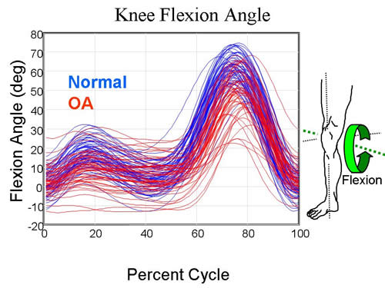
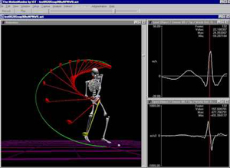
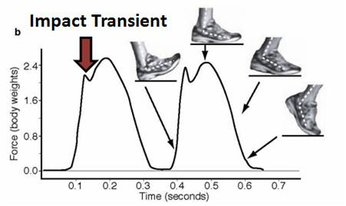
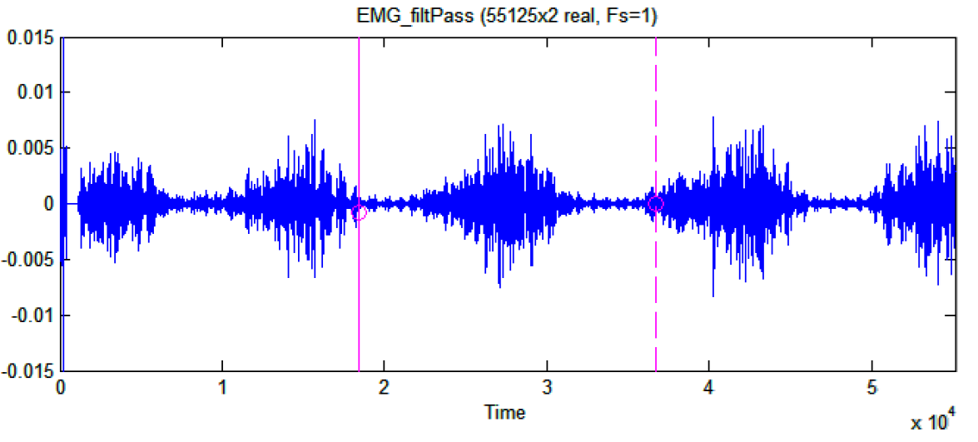
Introduction
Human movement / biological data often present as curves
It is crucial to summarize/analyse these data correctly

Slide 4
Introduction
Knee Osteoarthritis (OA) study
How do we best summarize these curves?
Notes:
Guide students through this first graph

Slide 5
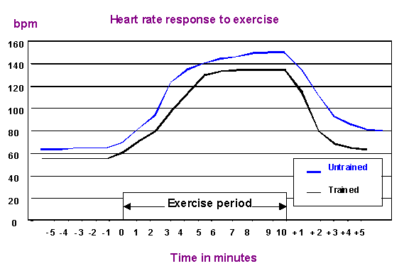
Introduction
Heart rate response to exercise
How do we know if trained/untrained individuals respond to exercise differently?
Is heart rate different across all time periods?
What statistical tests can we conduct?

Slide 6
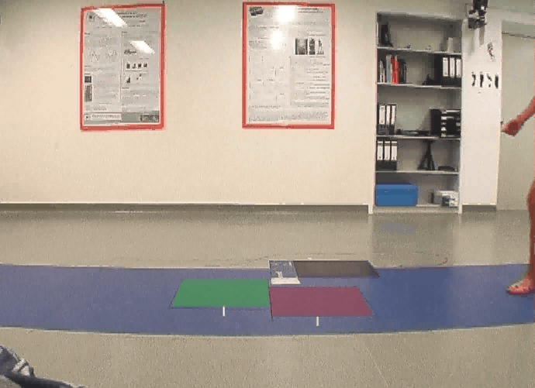
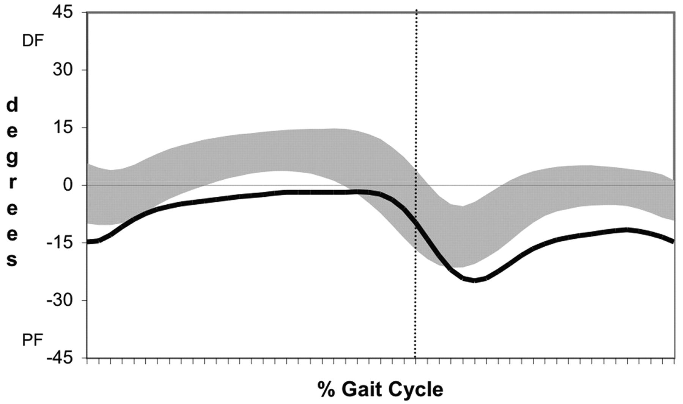
Introduction
Clinical gait analysis
How does a patient’s gait compare to controls?
Control SD
Patient
Sometimes patient data is within control standard deviation
Notes:
Cu some words here

Slide 7

Introduction
Two main problems:
(1) How to represent variability of curve data?
(2) How to determine if two (or more) curves
are significantly different?
2
Notes:
Cu some words here

Slide 8
Curve Variability
1

Slide 9
Curve Variability: Standard Deviation
Mean
+
Standard deviation (s)
What does s tell us?
Not much…
“While [s] clouds objectively quantify trajectory variability, experimental design complexities conspire to dissolve the connection between variability and probability” (Pataky et al., 2015)

Slide 10
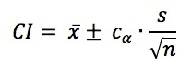
Curve Variability: Confidence Intervals
Confidence intervals (CI) are superior to s:
relationship between sample and population variability
can be estimated
e.g. 95% CI → 95% of the time, the true population mean
(μ) is contained by the CI
Usually 1.96 for normal distribution

Slide 11
Curve Variability: Confidence Intervals
It has been shown that the application of a point-by-point CI over a curve results in smaller than expected coverage (Lenhoff et al. 1999)
Why?
How can this be resolved?

Slide 12
Curve Variability: Multiple Comparisons
When we create a CI, we basically run a significance test:
→ For a given point on the curve, there is 5% chance that the true
population mean is not contained by the 95% CI (Type I error)
As we look at more points, it becomes likely that the CI will not contain the true population mean at some point along the curve
The width of the CI needs to be made larger with every point analysed to ensure the theoretical coverage is maintained
Notes:
Add graph of simplified data

Slide 13
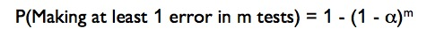

Curve Variability: Multiple Comparisons
What is the overall (family-wise) chance that we have committed a Type I error over only 5 points on a curve (at the α = 0.05) level?
This error increases with each test!
→ 22.6%
For 100 points, we are fairly certain that an error has been committed!
Notes:
-This next example comes from my master’s thesis work and really provides the motivation for why I started looking at curve analys more closely

Slide 14
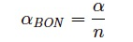
Curve Variability: Multiple Comparisons
There are a number of “classical” approaches to controlling family-wise error rates:
Tukey
Scheffe
Bonferroni correction
A Bonferroni correction for 101 data points (α_{BON} = 0.0005) would be like putting a 99.995% CI (Too conservative!)
Other approaches can be implemented…
Notes:
-This next example comes from my master’s thesis work and really provides the motivation for why I started looking at curve analys more closely

Slide 15

The Bootstrap Method: Background
Developed by B. Efron in 1979
Rare in movement science, but widely cited in other fields (≈ 97 000 times)
Bootstrapping is a purely data driven method where statistical parameters are estimated by randomly resampling (with replacement) from the sample at hand.
e.g. x = {5,12,13} → x_{resamp1} = {5,12,12}
x_{resamp2} = {5, 5,13}
Notes:
Cu some words here

Slide 16
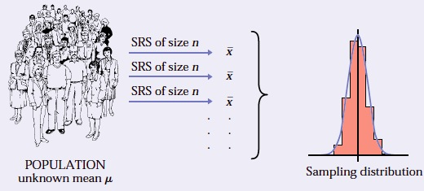
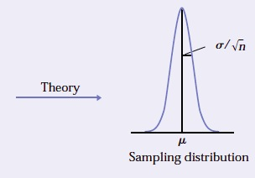
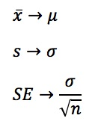
The Bootstrap Method: Background
We usually have to rely on a single sample and use theoretical arguments to make inferences about the population
Sample → population
Notes:
Cu some words here

Slide 17
The Bootstrap Method: Background
If we could collect many single random samples (SRS), we would know the shape of the sampling distribution and not have to worry about theory…

Slide 18
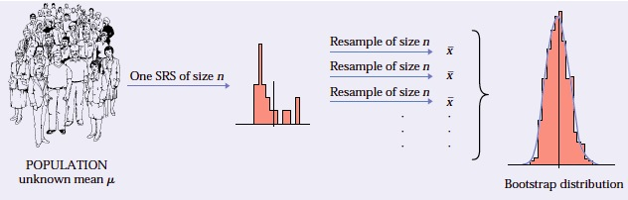
The Bootstrap Method: Background
The Bootstrap uses a single sample to create a Bootstrap distribution
The sample itself is treated as the population, from which many Bootstrap samples are draw!
The Bootstrap samples reproduce what we would expect from theory (Singh et al. 2010)
Notes:
Cu some words here

Slide 19

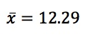
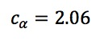
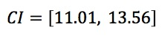
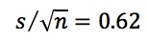
The Bootstrap Method: An exercise
Knee Osteoarthritis (OA) study
Compute the 95% CI at one-point along the curve (max in stance) for the OA group (red) using theory
-Access data at: https://github.com/PhilD001/Bootstrap-Curves
-Load test_data.xlsx
Notes:
Add graph of simplified data

Slide 20

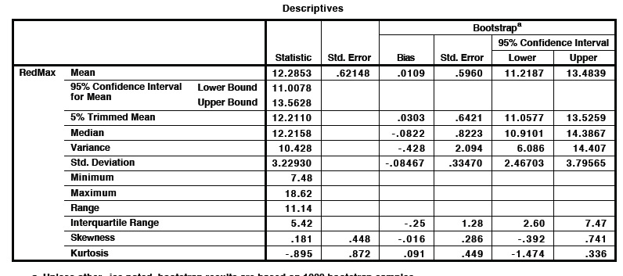
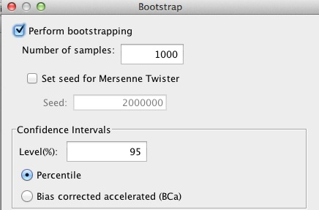
The Bootstrap Method: An exercise
Computing the 95% CI using the percentile
Bootstrap approach in SPSS
Open file “test_data.sav” (contains data for red group)
Navigate to: Analyse → Explore → Bootstrap
Choose “percentile approach”
Notes:
Add graph of simplified data

Slide 21
The Bootstrap Method: An exercise
Percentile Bootstrap procedure in SPSS:
1000 Bootstrap estimates of the mean are computed
1000 Bootstrap estimates of the mean are sorted
Means corresponding to the 2.5th and 97.5th percentile are chose as CI
Notes:
Add graph of simplified data

Slide 22

The Bootstrap Method: An exercise
Computing the 95% CI using the Bootstrap-t
approach in Matlab:
Compute 1000 estimates of the mean of the sample data:
(2) Use the original CI formula to compute Bootstrap CI:
Notes:
Add graph of simplified data

Slide 23
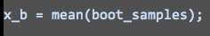
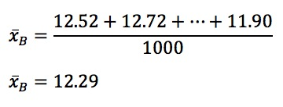
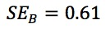
The Bootstrap Method: An exercise
Computing the 95% CI using the Bootstrap-t
approach in Matlab:
(3) Compute overall mean:
(4) Compute standard error
Notes:
Add graph of simplified data

Slide 24
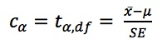
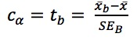
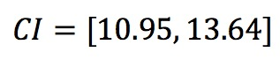
The Bootstrap Method: An exercise
Computing the 95% CI using the Bootstrap-t
approach in Matlab:
(5) Compute c_{α} statistic
Recall that t-table values are based on t-statistic:
Bootstrap version:
We get 1000 estimates of the t-statistic, extract 97.5% percentile value:
Finally:
Notes:
Add graph of simplified data

Slide 25
The Bootstrap Method: An exercise
Comparison of CI computation approaches
 | Normal | Student-t | Bootstrap-% (SPSS) | Bootstrap-t (Matlab)
Mean | 12.29 | 12.29 | 12.31 | 12.29
Standard error | 0.62 | 0.62 | 0.60 | 0.62
c_{α} | 1.96 | 2.06 | 1.98 | 2.22
CI | [11.07, 13.5] | [11.01, 13.57] | [11.22, 13.48] | [10.95, 13.64]
Bootstrap-t most conservative
Can be expanded to curve analysis
Notes:
Add graph of simplified data

Slide 26
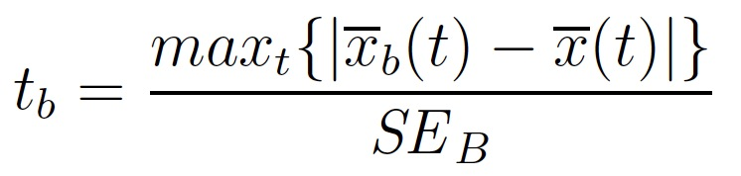
From confidence intervals to confidence bands
Curve Variability: The Bootstrap Approach
How can we adjust t-statistic (c_{α}) for entire curve?
→ Recall: we want the confidence band (CB) to include the true
mean 95% of the time
For a curve, t_{b} is (Lenhoff 1999)
→ This band contains 950 of the 1000
Bootstrap mean estimates
Notes:
Add graph of simplified data

Slide 27
Curve Variability: The Bootstrap Approach
(1) CI computed as before, except c_{α} statistic is estimated over entire curve:
We get c_{α} = 3.18
This variability cloud is
representative of the true CI
level (95%) over the entire curve
“pay the price” for having
confidence in the variability
over entire curve
Notes:
Add graph of simplified data

Slide 28
Statistical Analysis of Curves
2

Slide 29
Statistical Analysis of Curves: Bootstrap Approach
Knee Osteoarthritis (OA) study
Are the conditions significantly different?
Hypotheses: H₀(t): μ_{R}(t) – μ_{B}(t) = 0
H₁(t): μ_{R}(t) – μ_{B}(t) ≠ 0
If the difference confidence band (CB) does not contain 0, reject H₀
Reject H₀
|------------|
Fail to reject H₀
|-------------------|
Notes:
Add graph of simplified data

Slide 30
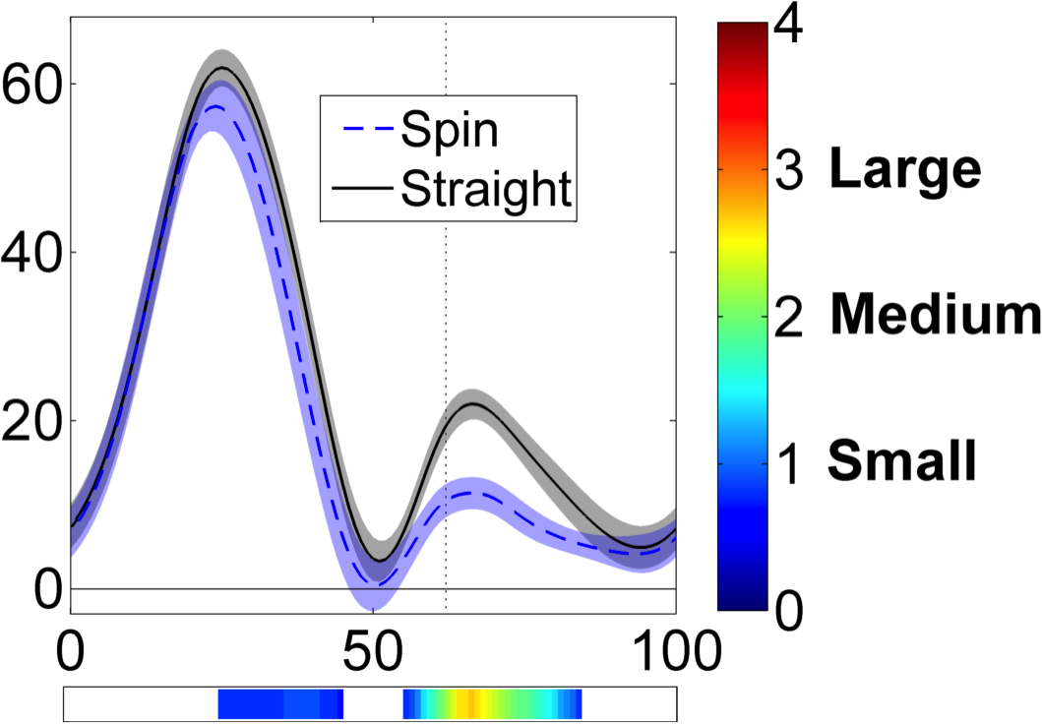
Statistical Analysis of Curves: Bootstrap Approach
Computing statistical differences using the Bootstrap CB approach:
Compute 1000 Bootstrap estimates of the difference curves
Compute CB of the differences:
Notes:
Add graph of simplified data

Slide 31
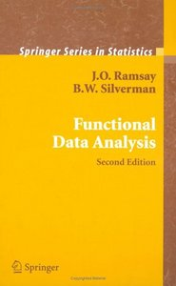
Statistical Analysis of Curves: FDA approach
FDA: Functional Data Analysis
Developed at McGill by J.O. Ramsay
http://www.psych.mcgill.ca/misc/fda/
Transforms individual points on a curve into a single mathematical function
Statistical techniques can then be applied to the entire curve, instead of to discrete points on a curve
Notes:
Cu some words here

Slide 32
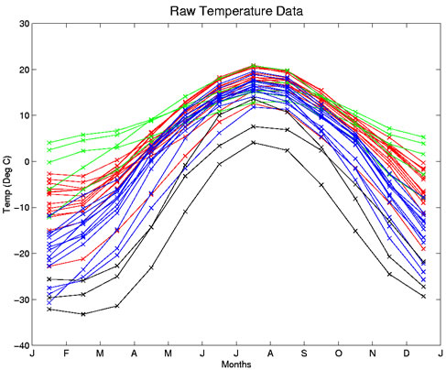
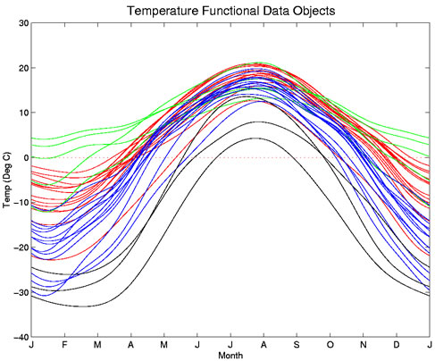
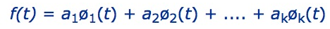
Statistical Analysis of Curves: FDA approach
Weather across Canada: Which regions are the coldest?
Pacific
Atlantic
Continental
Arctic
Discrete temperature readings
Temperature functional objects
Statistically analyse coefficients across curves
Difficult to pick coefficients→
Notes:
Cu some words here

Slide 33
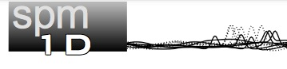
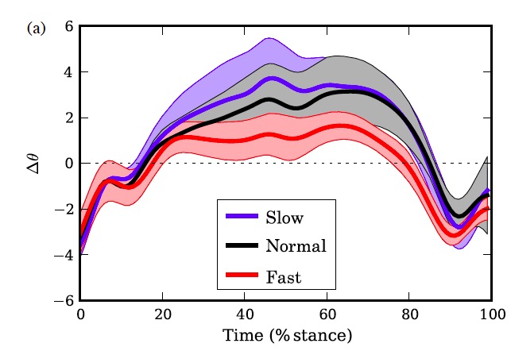
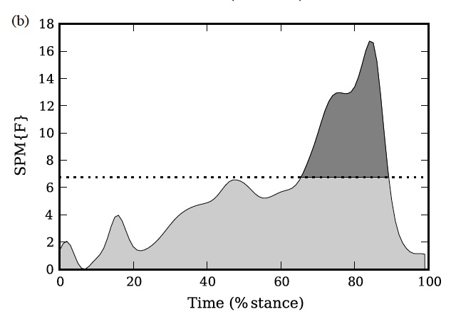
Statistical Analysis of Curves:
Statistical Parameter Mapping (SPM) Approach
Introduced to biomechanics
by T. Pataky
www.spm1d.org/
Makes probabilistic conclusions based on curve properties
α = 0.05 threshold
Data curves
Continuous F-ratio from ANOVA
Notes:
Cu some words here

Slide 34
Evaluating results
With point-by-point CI the width is too small, so we may commit Type I error
With Bootstrap CB we are confident that the we have achieved theoretical coverage
Notes:
Add graph of simplified data

Slide 35

Conclusions and recommendations
Do not display curves with standard deviation bands
Use (at the very least) confidence intervals, but mention the multiple comparison problem
Only conduct Bootstrap confidence band statistical analysis if you do not know have a priori assumptions about where differences may lie
Use Bootstrap approach with caution in more complex experimental designs
Notes:
Cu some words here

Slide 36



Take home message
The Bootstrap confidence band approach allows:
Variability of curves to be correctly estimated
Statistical differences between groups / conditions to be identified along the entire curve trajectory.
Thank you

Slide 37
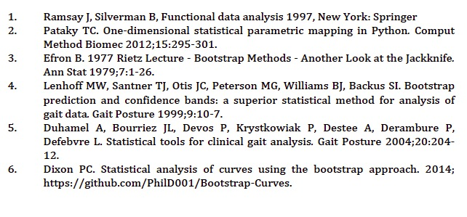
References
Notes:
Cu some words here

